Slide 1
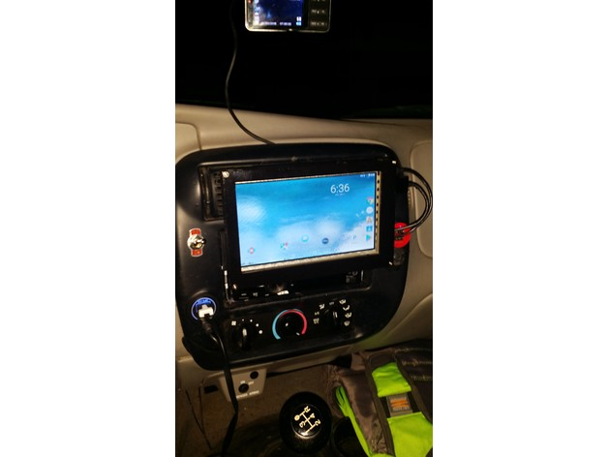
Proliferation of mobile and wireless devices
Smart phone- wireless, handheld, mobile device
Portable computer
Tablet PC
Internet tablet
Personal digital assistant
Ultra mobile PC
Carputer
Fly fusion pentop computer

Slide 2
Trends in mobility
3G, 4G…
iphones, android phones are examples of trends in mobility
Types of Mobility & its implications:
User mobility:
Device mobility
Session mobility
Service mobility(code mobility)

Slide 3
Types of attacks 3G mobile networks
1. malwares, viruses and worms
- skull trojan-series 60 phones
- cabir warm-infects phones running on Symbian OS.
-mosquito trojan- series 60 smart phones
- brador trojan- affects Windows CE, gets full control of device.
- lasco warm- 2005, PDA, mobile phones
2. DoS- make system unavailable to intended users.
DDoS IS most common attack on wired IPS
3. Overbilling attack- hijack IP addr and use for his own purpose

Slide 4
4. Spoofed policy development process (PDP): exploits vulnerabilities in the GTP.
5. Signaling level attacks: vulnerabilities in SIP based VoIP systes.

Slide 5
Credit card frauds in mobile and wireless computing era
New trends coming with mobile computing- m-commerce, m-banking.
Reason- increasing power, reducing cost
Mobile credit card transactions are very common since it allows transaction from mobile location quickly, efficiently and professionally.

Slide 6
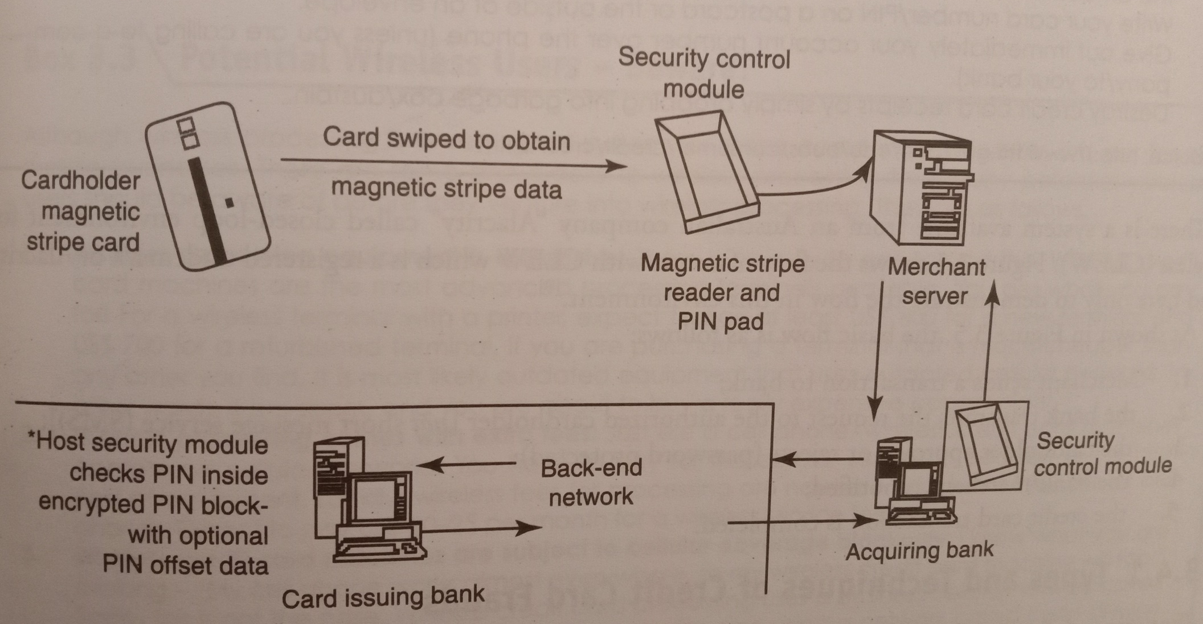

Slide 7
Flow of transaction using credit card
Merchant send transaction to bank
bank request to authorized card holder (sms)
Card holder approve or rejects transaction(password protected)
Bank/merchant is notified
Credit card transaction is completed

Slide 8
Credit card frauds
Methods to conduct
Account takeover
counterfeit cards
never received
fraudulent application
collusive merchants
triangulation

Slide 9
Types and techniques of credit card frauds
Traditional Techniques
Paper based fraud- application fraud (stolen/ fake documents)
A. ID theft
B. financial fraud
- Illegal use of lost or stolen cards.
2. Modern techniques
Sophisticated techniques(enable criminals to produce fake cards)
-skimming- information on magnetic stripe/ smart chip are copied from one card to other card

Slide 10
-site cloning and false merchant sites on internet (direct users to such bogus/ fake sites –phishing)
Triangulation
- criminal offers goods with heavy discount
- customer register on these websites
- criminal provides goods from legitimate website to customer
- transaction completes
- criminal continue to use stolen card details

Slide 11
Attacks on mobile/cell phones
targets- data, Identity, Availability
Mobile phone theft
necessity
Increase in mobile users
Public transport
Loses PII
Tips to secure mobile from being stolen/lost
preserve your phone details at safe place
Add security mark to your phone
set a strong password
in case of loss, register a complaint

Slide 12
get FIR
keep eye on mobile
keep wi-fi, Bluetooth off when not in use
periodic backup
update s/w, firmware time to time
download apps only from reputed sources
install anti theft s/w on your cell phone

Slide 13
Mobile viruses
Around 40 mobile virus families (300+)
First virus found in 2004
Easy spreading- internet download, Bluetooth and mms

Slide 14
Mishing
Mobile phone and phishing
Use of mobile for purchasing goods and banking makes it more vulnerable to a mishing scam.
Attacker ask for PI
Convince with different reasons

Slide 15
vishing
Social engg on phone
V-voice and phishing
To get PI
Includes Id theft, money transfer, ….

Slide 16
Vishing Process
1. War dialler or voice messaging system is used to call people.
2. Customer gets information about fraudulent activities on his bank account or credit card.
3. He is asked to contact bank regarding the same and provide contact details.
4. Called I'd is spoofed
5. On calling given no, automated instructions request to provide personal details.

Slide 17
How Vishing works
Through email
Mobile text msg
Voice mail
Direct phone call

Slide 18
How to protect from vishing attacks
Unknown callers
Don’t trust caller ID
Be aware
Verify authentication of caller
Report incidents to nearby cyber cell

Slide 19
Smishing
Sms-phishing
Sms can be abused as
pretexting, VoIP to gather information

Slide 20
How to protect from smishing attacks
Don’t answer sms asking for PI
Avoid calling on no mentioned in the received message
Never click on the hot link given in the message.

Slide 21
Hacking Bluetooth
Bluetooth: exchange data(2.4GHz freq range)
On- “I am here and I am able to connect”
Easy to identify target
Attackers installs Bluetooth hacking tools
Gets connected to available devices
Bluetooth hacking tools

Slide 22
Bluetooth hacking tools:
Bluescanner
Bluesniff
Bluebugger
Bluesnarfer
Bluediving

Slide 23
Common Bluetooth attacks
Bluejacking
Bluesnarfing
Bluebugging
Car-whisperer

Slide 24
Mobile devices: security implications for organisations
Benefits for enterprise:
improved workforce productivity
improved customer service
increased business process efficiency
employee safety and security
employee retention

Slide 25
if proper and strong security policies are not enforced, there is a huge risk of cyber attacks: loss, theft, misuse of confidential information.
malicious code
portable-loss, theft, damage
unique threat-jailbreak software
risks

Slide 26
Risk categorized in 5 areas:
1 physical access
2 malicious code
3 device attack
4 communication interception
5 insider threats

Slide 27
Security implications for organisations
Managing diversity and proliferation of handheld devices
Register mobile devices of employees in corporate asset register
Close monitoring of these devices
Remove physical and logical access when employee leaves
Mobile devices belonging to organization should be returned to IT dept

Slide 28
Mobility generation gap:
young workers
old workers

Slide 29
2. Unconventional / stealth storage devices:
-mobile phones, media players
-CDs, USBs
-difficult to detect
Prohibit employees to use these devices
-small size
-no security for usb ports
- need policy to block these ports

Slide 30
“device lock” software solution
- monitor users
Control access
Creates white list
set devices in read only mode
- Protect disc

Slide 31
3. Threats through lost and stolen devices:
-security risk to corporation

Slide 32
4. Protecting data on lost devices:
Need to address issue:
-data and running applications on device
-data protection: encrypting sensitive data, encrypting entire file system
-Org should have clear policy
-method to report loss of device
-write emergency contact on device itself

Slide 33
5. Educating the laptop users:
-tools in place to manage a internet access

Slide 34
Organizational measures for handling mobile devices related security issues:
unauthorised access
lost/stolen devices
employee leaving company
confidential files

Slide 35
Security features used to protect mobile assets
authentication
data encryption
provisioning
remote wipe and data fading
full disk encryption
separation of personal and enterprise information
user access rights and security policies
network filters

Slide 36
Organizational measures for handling mobile devices related security issues:
Encrypting organizational databases:
a. Rijndael
b. multidimensional space rotation(MDSR)
-strong encryption
-use of key
-deciphering is difficult
Performance impact
Do not store key on mobile

Slide 37
2. Including mobile devices in security strategy:
- technologies available to secure mobile devices.
Things enterprises can use:
-prohibit unauthorized access and entry of corrupted data
-investigate alternatives that allow a source access to company information
- frequent and thorough security audits
-security awareness in training
- monitor unusual activity for a period of time

Slide 38
Organizational security policies and measures in mobile computing era
Importance of security policies for mobile computing devices:
Sensitive information stored on mobile devices/ secondary storage devices
If get stolen-PR disaster-violates laws and regulations
If controls can not be implemented to protect data on the stolen devices, prevent users from storing data on insecure platforms.
Difficult but by increasing awareness can be implemented effectively.

Slide 39
Organization should adhere to the following rules for effective mobile device management:
Identify all mobile devices on the network
Know which back office systems employees need to access
Formalize user types and set policies
Be ready to block access
Add password and encryption policies plus remote wipe
Consider separating personal data from business data.
Enable users to be self sufficient

Slide 40
Steps to secure mobile devices:
1. Configure mobile devices securely by
Enable auto-lock
Password protection(complex)
Avoid use of auto complete features(remember username, password)
Browser security settings should be configured properly
Enable remote wipe
Enable SSL protection

Slide 41
2. Connect to secure Wi-Fi, disable Bluetooth, infrared, wi-fi when not in use
3. Update mobile devices frequently
4. Use antivirus, update it
5. Use encryption to keep portable data secure in transit
- install encryption solution
- mobile encryption options
- avoid storing data on mobile
6. Use digital certificates on mobile devices.
7. Physical security measures to avoid theft

Slide 42
-cable locks for laptops
-tracking-tracing app
-don’t leave mobile device unattended
-report lost of device
- data backup
8. Sanitization and disposal procedures for mobile devices
9. Develop policies, procedures, standards and guidelines for mobile devices
10. Educate employees about mobile device security
-cautious while clicking attachments
-aware about downloads
-aware about current threats affecting mobiles

Slide 43
Audit procedures for mobile devices
Policy
Antivirus update
Encryption
Secure transmission
Device management
Access control
Awareness training
risk

Slide 44
Laptops
Enable us to work whenever and wherever we want
Enhance productivity
Put confidential data on risk(drawback)
To reduce risk and impact of data loss, organization must secure data on laptop.

Slide 45
Basic security principles need to be followed for laptops:
Choose a secure operating system and lock it down
Enable a strong password
Engrave the laptop
Register the laptop with the manufacturer
Get a cable lock and use it
Use a docking station
Lock up your PCMCIA cards
Use a personal firewall on your laptop
Use tracking software to have your laptop call home

Slide 46
Online Drug Trafficking
The Internet is becoming increasingly popular among individuals and organised crime groups as a platform for trafficking synthetic drugs.
The role of the Internet in the facilitation of trafficking has gained attention since the closure of several Clearnet and darknet websites, also known as marketplaces.
Synthetic drugs are sold on social media, Clearnet websites and the darknet.
Online trafficking may have a significant impact on the overall trafficking of drugs.

Slide 47
Drug trafficking requires that the criminal physically make a transfer or transaction that involves human interaction.
Organized cybercrime does not require the criminal to be physically present at the scene of the crime, thus making it very difficult for law enforcement officials to capture him or her.
It’s much easier for a criminal to conduct nefarious activities online than to physically break into a bank or someone’s home.

Slide 48
What are the Challenges in tackling Drug Trafficking in India?
Dark Net: Darknet markets are difficult to trace because of their anonymity and low risks. They have taken over the traditional drug markets. Studies reveal that 62% of the darknet is being used for illicit drug trafficking.
The success rate in catching traffickers using the darknet has been very low the world over.

Slide 49
Transactions in Cryptocurrency: Cryptocurrency payments and doorstep deliveries, through courier services, have made darknet transactions attractive.
Traffickers have become Creative and Tech Savvy: The traffickers have adopted to new age technologies such as supplying drug and guns through drones in Punjab which have posed new challenges before the security forces.

Slide 50
Using more Safe and Anonymous methods: The drug traffickers have started relying more upon courier/parcel/post after the restrictions imposed on vehicular/ship/airline movement during Covid-19 pandemic.
In 2022, a person was arrested for doing the drugs business through making an e-commerce dummy website.
In one more instance, few persons were arrested for selling drugs through e-commerce websites like amazon by listing fake products on the website.

Slide 51
Work from home security risks and tips
How to stay safe when working from home
Use antivirus and internet security software at home
Keep family members away from work devices
Invest in a sliding webcam cover
Use a VPN
Use a centralized storage solution
Secure your home Wi-Fi
Beware of Zoom and video conferencing
Make sure your passwords are strong and secure
Protect your online banking
Be wary of email scams and your email security

Slide 52
Working from Home Security Tips for Staff
Are you using a comprehensive antivirus and internet security software at home?
Have you secured your devices – by keeping them safe from family members and ensuring that encryption is turned on and configured? Have you enabled “Find my device” and remote wipe on all your devices?
Have you invested in a web cam cover? If your webcam is external, do you unplug it when not in use?

Slide 53
Are you using a VPN?
Have you secured your home Wi-Fi?
Have you made sure that your passwords are strong and secure?
Are you alert to the dangers of phishing scams, avoiding clicking on links or opening attachments in any emails you are unsure of?

Slide 54
Are you using a supported operating system, and do you keep your operating system up to date?
Do you keep all software up to date?
Have you enabled two-factor authentication where appropriate, or considered the use of an authenticator app such as Google Authenticator or Authy?
During video calls, do you take care not to over share your screen and are you mindful of what might be in the background?

Slide 55
Working from Home Security Tips for Employers
Do you have a documented work from home security policy? A good example from the Information Commissioner’s Office can be found here.
Do you have a BYOD (Bring Your Own Device) policy?
Do you provide cyber security awareness training to employees?
In particular, do you train staff to be alert to phishing attacks and how to avoid falling victim to them?
Are you ensuring that staff use a VPN, and is this set up correctly and kept up to date with security patches?

Slide 56
Is the platform you use for staff video teleconferencing secure with end-to-end encryption?
Do you use a centralized storage solution – i.e. safe data storage in the cloud – and encourage staff to backup data regularly?
Are company devices secured by company-approved antivirus software?
Do you encourage employees to have strong and safe passwords, and have you considered the use of a Password Manager?

Slide 57
Do you encourage the use of two-factor authentication to validate credentials?
Do you use encryption software to protect company data by barring access to any unauthorized users?
Do you advise staff to use corporate email solutions and not to rely on their own email or messaging accounts for the storage or transmission of personal data?

Slide 58
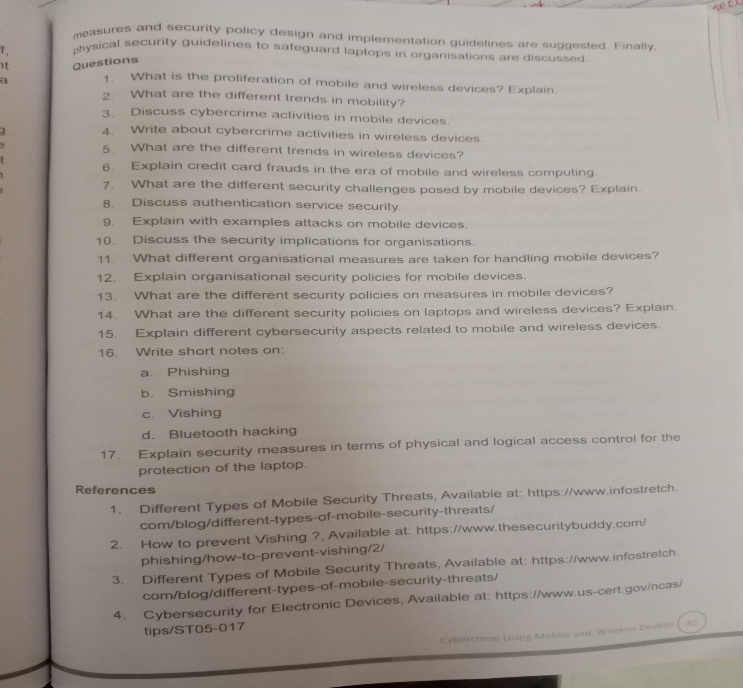
Questions on unit 2

